Slide 1
A Novel Two-Stage Deep Learning Model for Network Intrusion Detection: LSTM-AE
PAPERLINK:https://drive.google.com/file/d/1bkCIfRwU4JiVT-CT3m4vK06iGpLKF6Qb/view?usp=sharing
Author:Yong Hwa-Kim (yongkim@ut.ac.kr)
- YUVARAJUREDDY SIRIPIREDDY
700766846

Slide 2
Motivation
In today's digital age, the rapid evolution of cyber-attacks poses a significant threat to network security, necessitating advanced and adaptive Intrusion Detection Systems (IDS).
Traditional methods often fall short in recognizing sophisticated and evolving attack patterns. Thus, leveraging deep learning techniques such as Long Short-Term Memory (LSTM) networks and Auto-Encoders (AE) presents a promising approach to enhance the detection and classification of cyber-attacks.
This research aims to develop a robust and flexible IDS capable of addressing modern cybersecurity challenges through the proposed hybrid LSTM-AE model, evaluated using updated and comprehensive intrusion detection datasets.

Slide 3
Problem Statement
Despite the advancements in Intrusion Detection Systems (IDS) using deep learning techniques, existing models often fail to effectively recognize and classify the rapidly evolving and increasingly sophisticated cyber-attacks. Furthermore, the lack of comprehensive evaluation across various publicly accessible intrusion detection datasets limits the ability to benchmark and enhance these models. This research addresses these challenges by proposing a novel hybrid model combining Long Short-Term Memory (LSTM) networks and Auto-Encoders (AE), evaluated using the CICIDS2017 and CSE-CICDIS2018 datasets, to improve the detection accuracy and adaptability of IDS in modern cyber-attack scenarios.

Slide 4
Objectives
∙ Develop a Novel IDS Model: Design and implement a two-stage deep learning model combining Long Short-Term Memory (LSTM) networks and Auto-Encoders (AE) for enhanced intrusion detection.
· Evaluate Using Comprehensive Datasets: Utilize the CICIDS2017 and CSE-CICDIS2018 datasets to determine the optimal network parameters and assess the performance of the proposed hybrid model.
· Benchmark Against Existing Models: Compare the detection accuracy and adaptability of the proposed LSTM-AE model with existing deep learning models such as Deep Neural Networks (DNN) and Convolutional Neural Networks (CNN).
· Address Dynamic Attack Patterns: Ensure the model's capability to recognize and adapt to the rapidly changing nature of cyber-attacks and evolving network behaviors.
· Promote Continuous Improvement: Highlight the importance of regularly updating and benchmarking intrusion detection datasets to keep pace with new and sophisticated attack techniques.
· Enhance Cybersecurity Research: Contribute to the cybersecurity research community by providing insights and methodologies for developing more effective IDS models.

Slide 5
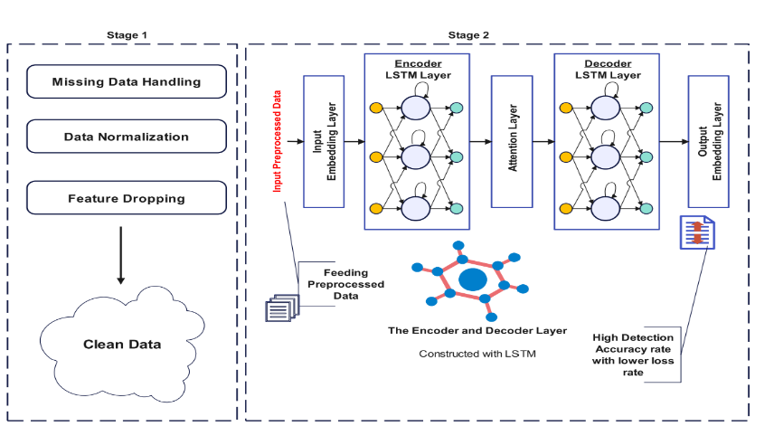
LSTM-AE Framework

Slide 6
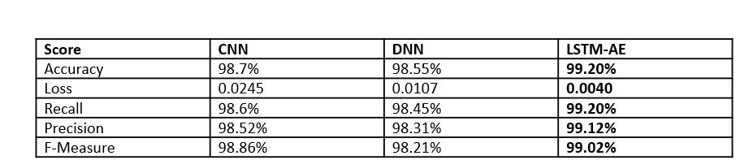
Results
The proposed LSTM-AE hybrid model demonstrated a significant improvement in detection accuracy compared to traditional DNN and CNN models.This suggests that the hybrid approach is better at handling the complexities and nuances of modern cyber-attacks.
The model proved to be scalable and adaptable, maintaining high performance across different network scenarios and attack types. This highlights its potential for real-world applications where network conditions and attack patterns are constantly evolving.
The LSTM-AE hybrid model demonstrated robustness in handling both static and dynamic attack scenarios, showing resilience to adversarial attacks and variations in network traffic. This contributes to its reliability in diverse and unpredictable network environments.

Slide 7
Contributions
I focused on enhancing intrusion detection systems (IDS) using deep learning techniques. I proposed a novel approach combining Long Short-Term Memory (LSTM) and Auto-Encoders (AE) in a two-stage model. By evaluating this model on widely-used datasets, I demonstrated its effectiveness in detecting modern cyber-attacks. This research contributes by offering a new method to improve IDS performance, crucial for safeguarding networks against evolving cyber threats.
Presenting a two stage Deep Learning-based IDS by hybridizing an LSTM and an AE termed LSTM-AE, where data has been filtered in order to lessen the over-fitting and under-fitting.
The LSTM-AE can effectively balance the dimensionality reduction and feature retention in highly imbalanced datasets. Therefore, the proposed model has been tested with two datasets.
The LSTM-AE has a much higher detection performance than other popular intrusion detection models.

Slide 8
Critical Analysis
The article presents a compelling advancement in intrusion detection systems by proposing a hybrid model that combines Long-Short Term Memory (LSTM) networks with Auto-Encoders (AE). The model’s promising results in terms of improved detection accuracy and efficiency suggest a significant step forward in addressing the challenges of modern cyber-attacks.
One of the strengths of the article is its clear demonstration of how the LSTM-AE model outperforms traditional deep learning approaches on the CICIDS2017 and CSE-CICDIS2018 datasets. This improvement in precision and recall indicates that the model effectively captures complex attack patterns and adapts to evolving threats. The careful optimization of network parameters also highlights a strong commitment to enhancing the model's performance and practical applicability.
Although the paper focuses on specific datasets, this choice provides a solid foundation for evaluating the model's capabilities. Future work could expand on this by testing the model across a wider range of datasets and real-world scenarios, which would further validate its robustness and generalizability. The potential for the model to handle diverse network conditions and attack types is promising and could lead to significant improvements in real-time intrusion detection

Slide 9
References
D. Chou and M. Jiang, ‘‘A survey on data-driven network intrusion detection,’’ ACM Comput. Surv., vol. 54, no. 9, pp. 1–36, Oct. 2021, DOI: 10.1145/3472753
H. Wang, J. Gu, and S. Wang, ‘‘An effective intrusion detection framework based on SVM with feature augmentation,’’ Knowl.-Based Syst., vol. 136, pp. 130–139, Nov. 2017, DOI: 10.1016/j.knosys.2017.09.014.
J. Jiang, M. Chen, and J. A. Fan, ‘‘Deep neural networks for the evaluation and design of photonic devices,’’ Nature Rev. Mater., vol. 6, pp. 679–700, Dec. 2020, DOI: 10.1038/s41578-020-00260-1
G. Lu and X. Tian, ‘‘An efficient communication intrusion detection scheme in AMI combining feature dimensionality reduction and improved LSTM,’’ Secur. Commun. Netw., vol. 2021, pp. 1–21, Apr. 2021, DOI: 10.1155/2021/6631075

Slide 10
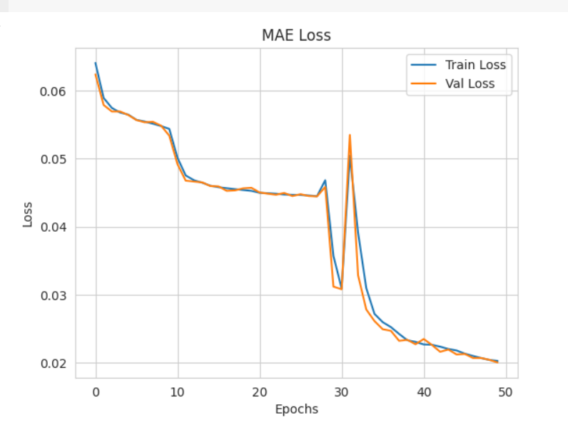
MAE LOSS

Slide 11
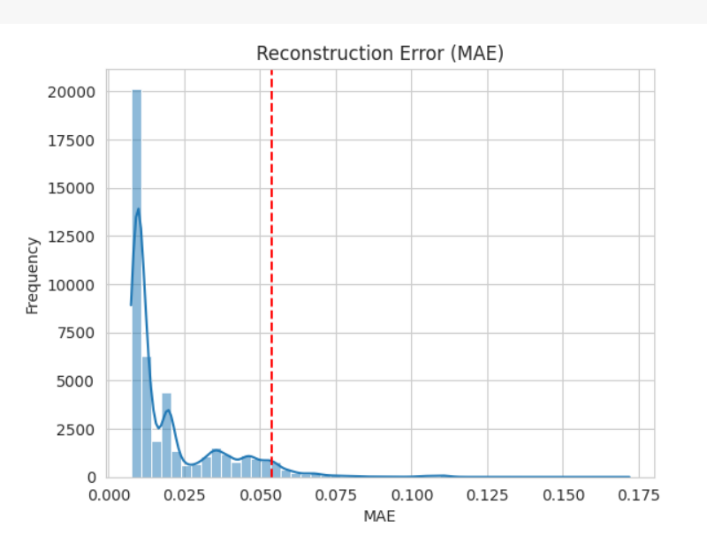
Reconstruction Error

